Slide 1
SHOBOT WEEKLY REPORT
J JAYAGOWTHAM
ME21B078

Slide 2
TESTING OF THE SCARA ARM
We were testing the new SCARA arm with my system
I learnt the different commands to operate the arm
We tried different possibilities of the arm and the result was fruitful
We tested the payload, extrema in rotation in each arm and extrema in lift motion

Slide 3
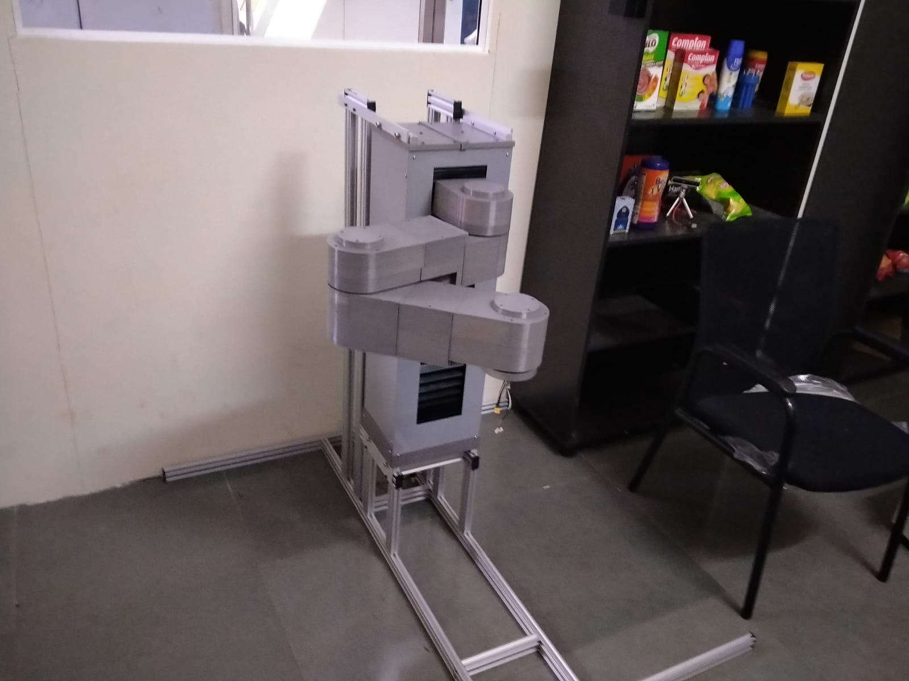
Fig.1 SCARA Arm

Slide 4
OTHER RELEVANT WORK
I found out a python library (pixeltocamera.projectpixelto3dray) which gives us real world coordinates of the center of our object with respect to the camera in x and y direction
In order to completely implement it, we need the Realtime coordinates of camera, which I hope I can acquire with the help of people working with the arm
We also recorded the performance of the model to present it in the meeting.

Slide 5
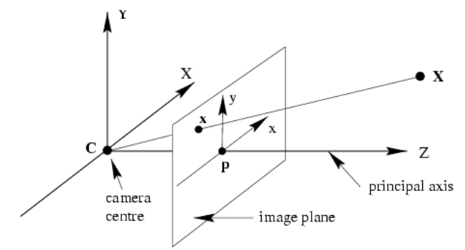
Fig.2 Expected Output

Slide 6
FURTHER PLAN
Coordinate with other members to get the Realtime coordinates of the camera
Coding the coordinates for the object once we get the coordinates of the camera
Testing the robot with our new code

